Slide 1
Descriptive Analysis: CO2 Emissions
Author: Jamie Parra
CEN 4930 – Exploratory data analysis

Slide 2
Dataset
Dataset consists of vehicle manufacturers with their model vehicles and their corresponding engine specifications, fuel mileage, and emissions.
https://www.kaggle.com/datasets/bhuviranga/co2-emissions

Slide 3
Dataset
Variable Name | Data Type | Field Size | Description | Example
Make | Categorical | 20 | Vehicle Manufacturer | Chevrolet
Model | Categorical | 20 | manufacturer vehicle type | Silverado
Vehicle Class | Categorical | 20 | Chassis category | Pickup Truck - standard
Engine Size(L) | Numerical | 2 | Engine Displacement | 5.3
Cylinders | Numerical | 2 | Engine cylinders | 8
Transmission | Categorical | 7 | Vehicle transmission | A6
Fuel Consumption City | Numerical | 4 | Mpg city | 10.3
Fuel Consumption Hwy | Numerical | 4 | Mpg hwy | 14.6
Fuel Consumption Combined | Numerical | 4 | Combined City & Hwy | 12.7
CO2 Emissions | Numerical | 4 | Engine emissions in g/km | 292

Slide 4
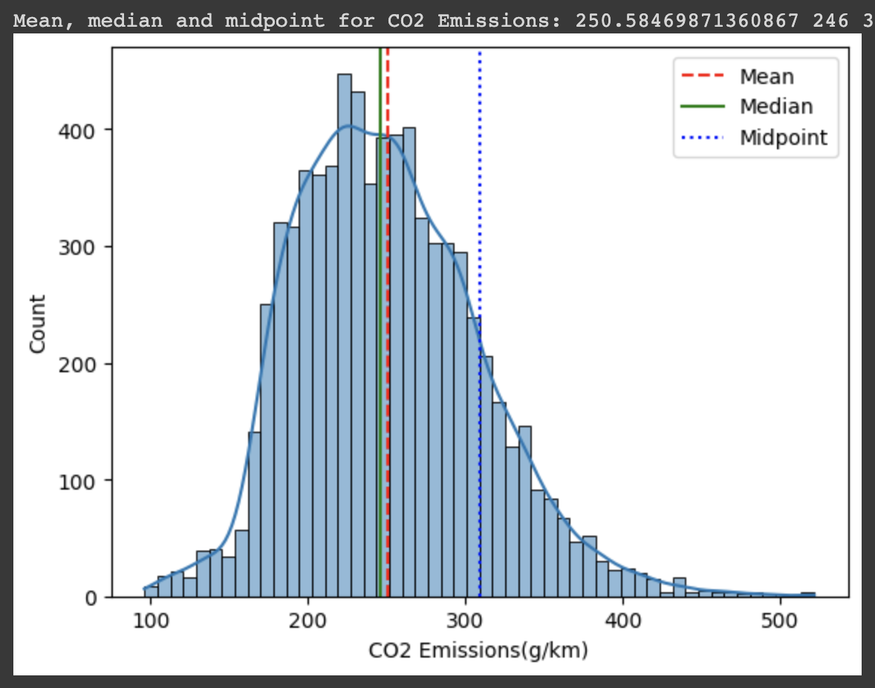
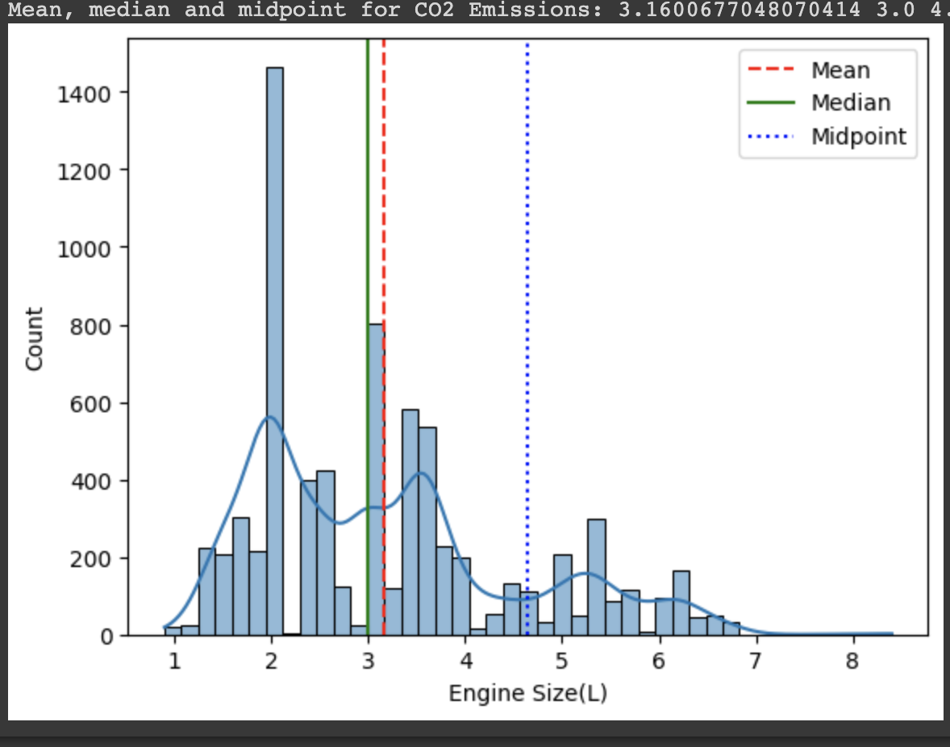
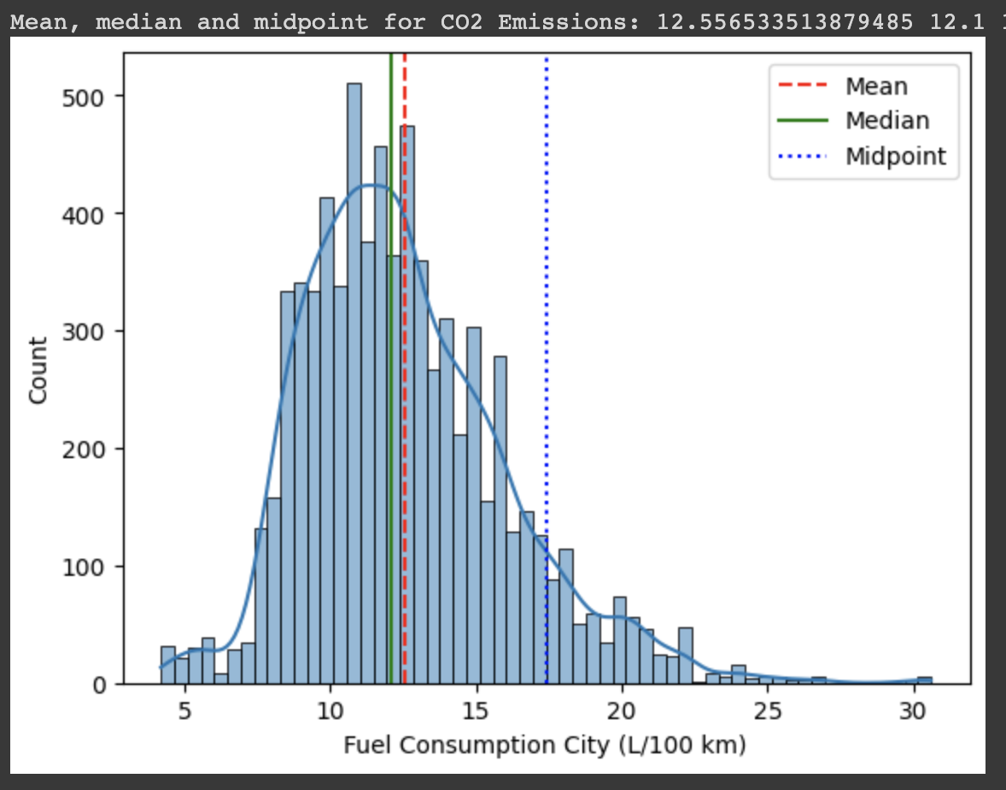
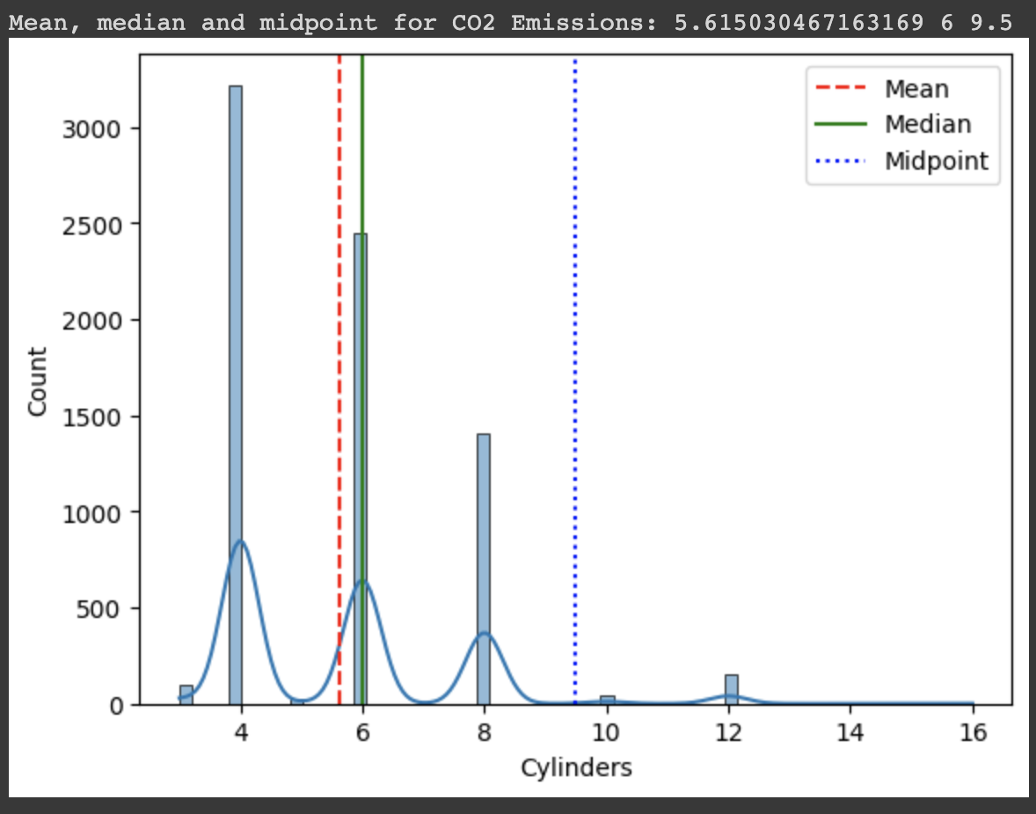
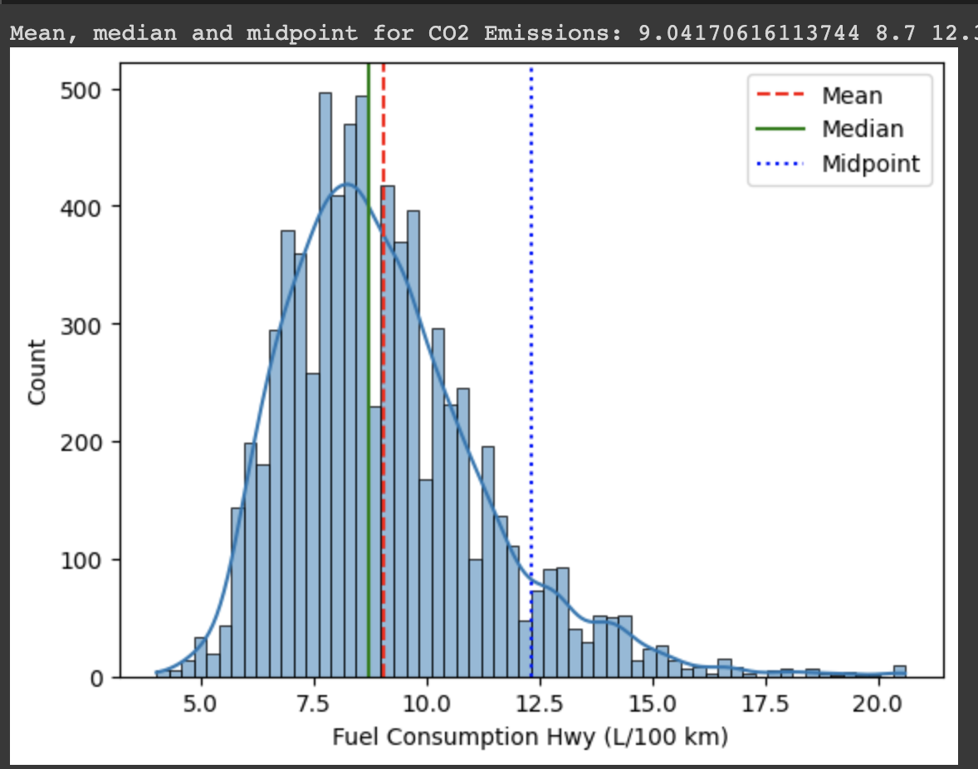
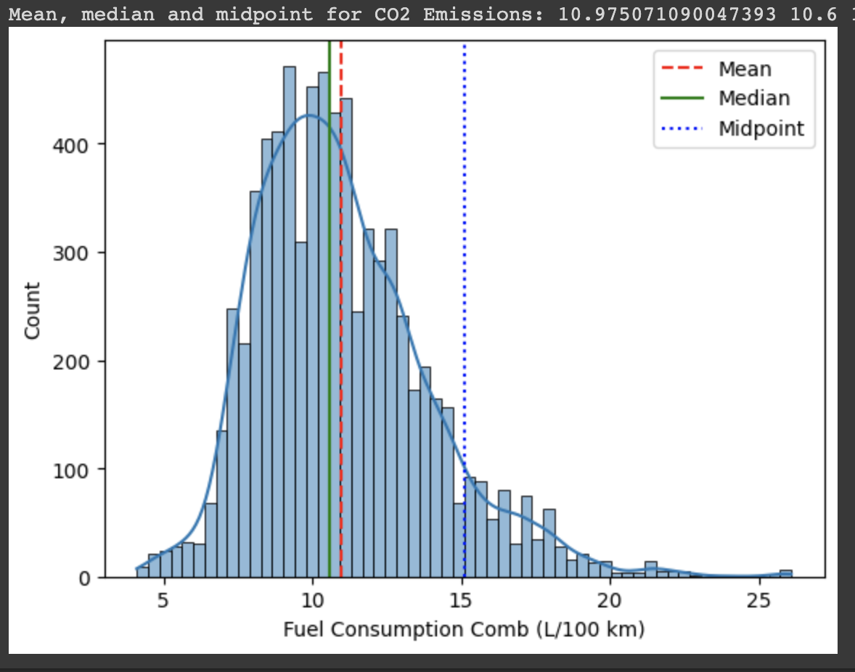
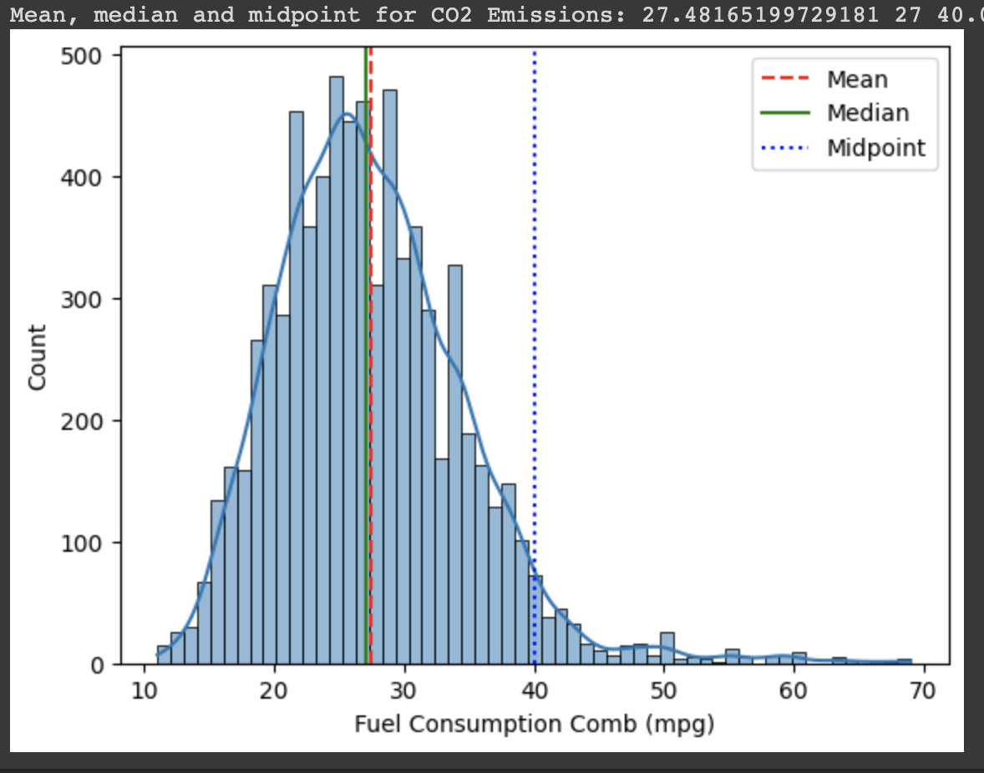
Central Tendency Measures

Slide 5
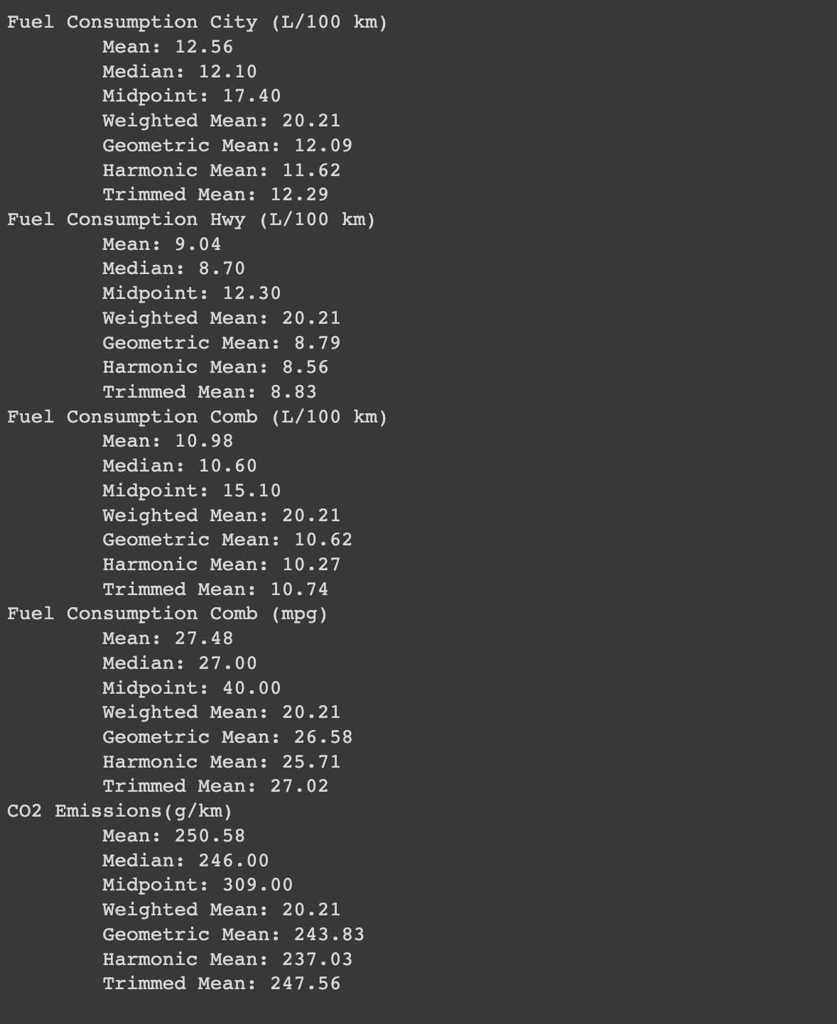
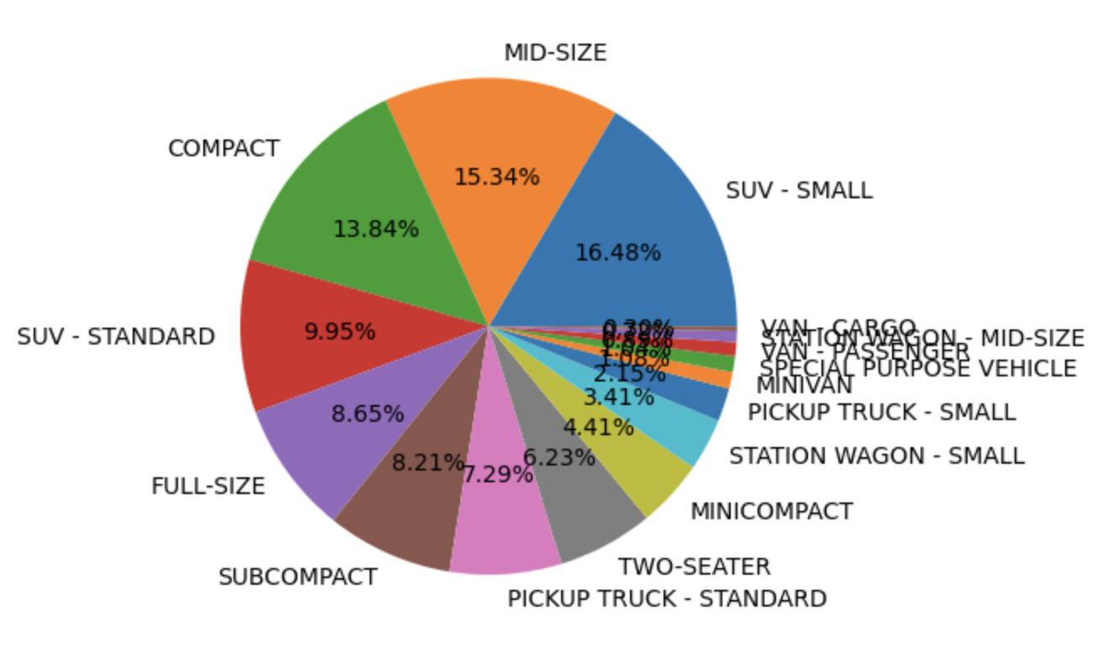
Central Tendency Measures

Slide 6

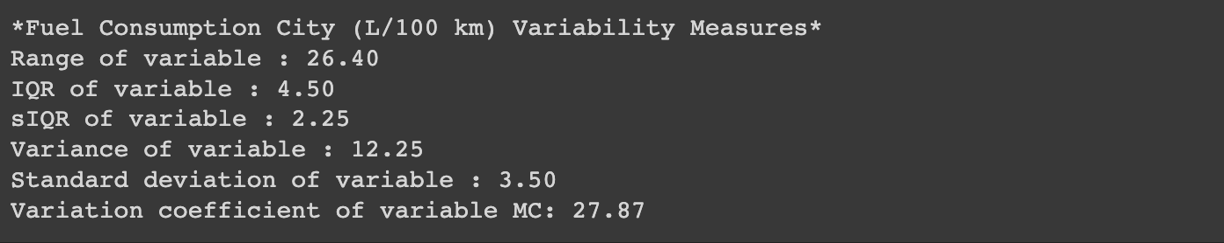
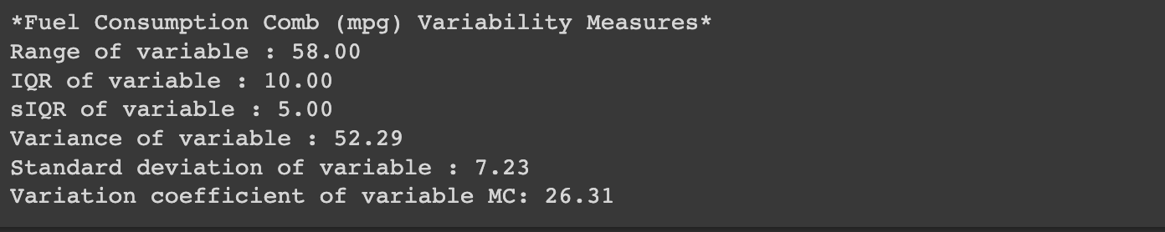
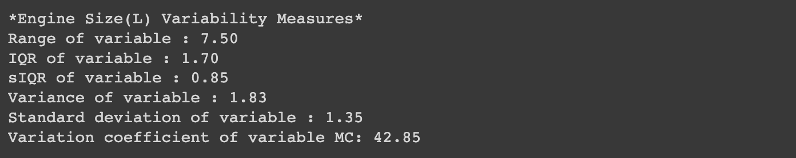
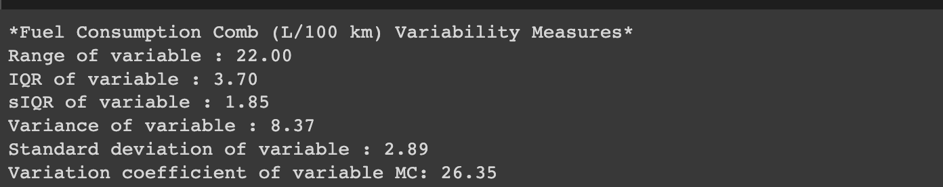
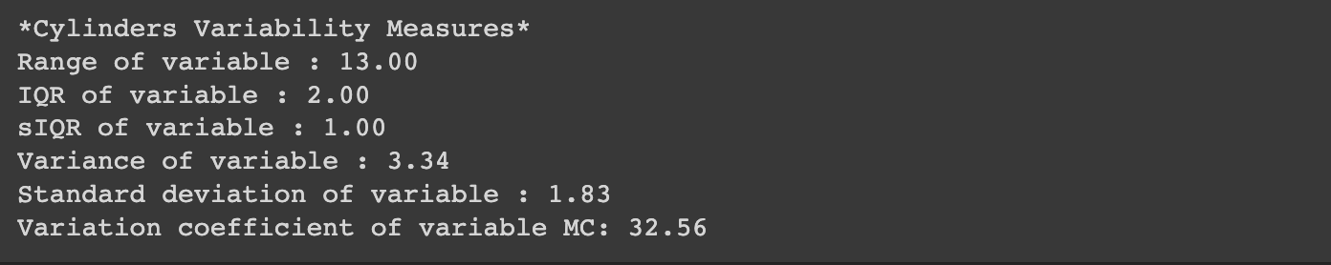
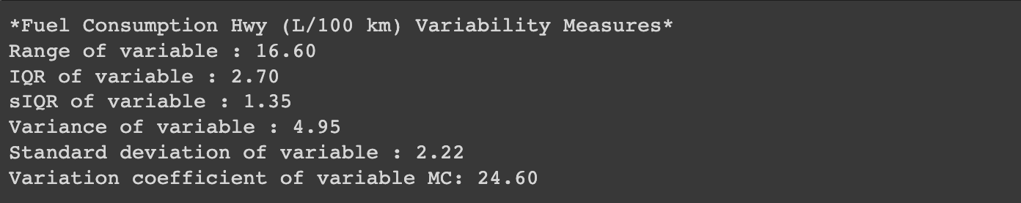
Dispersion Measures

Slide 7
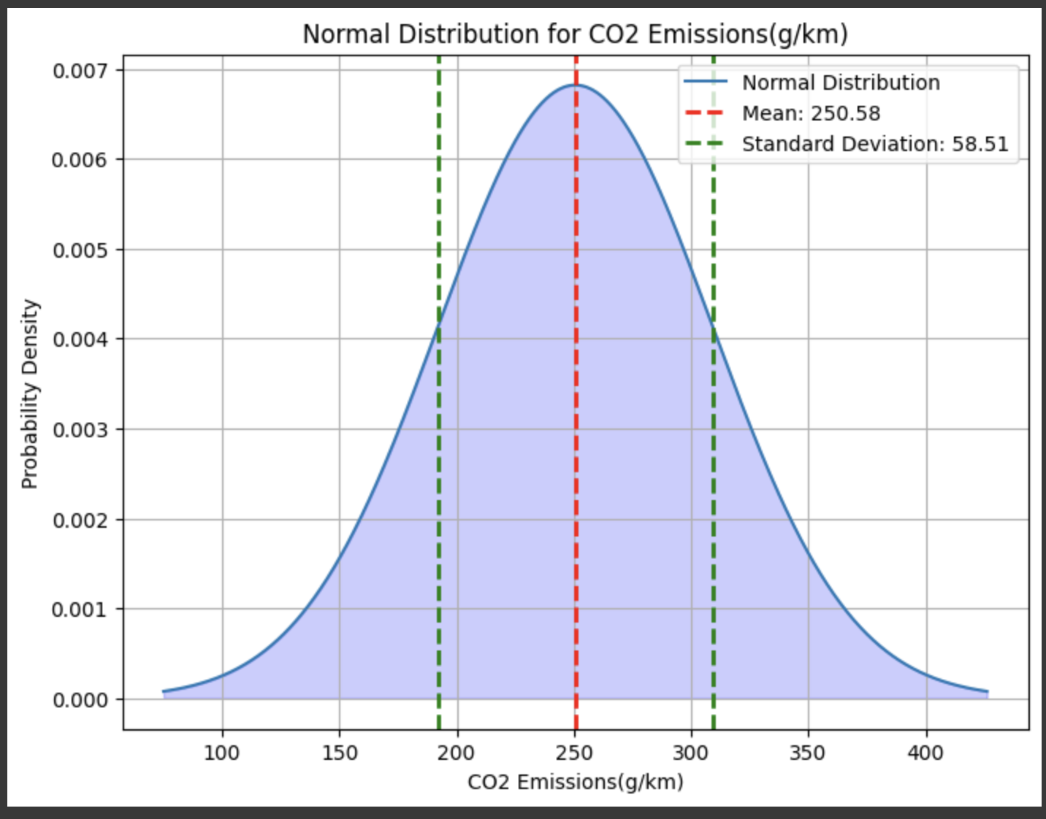
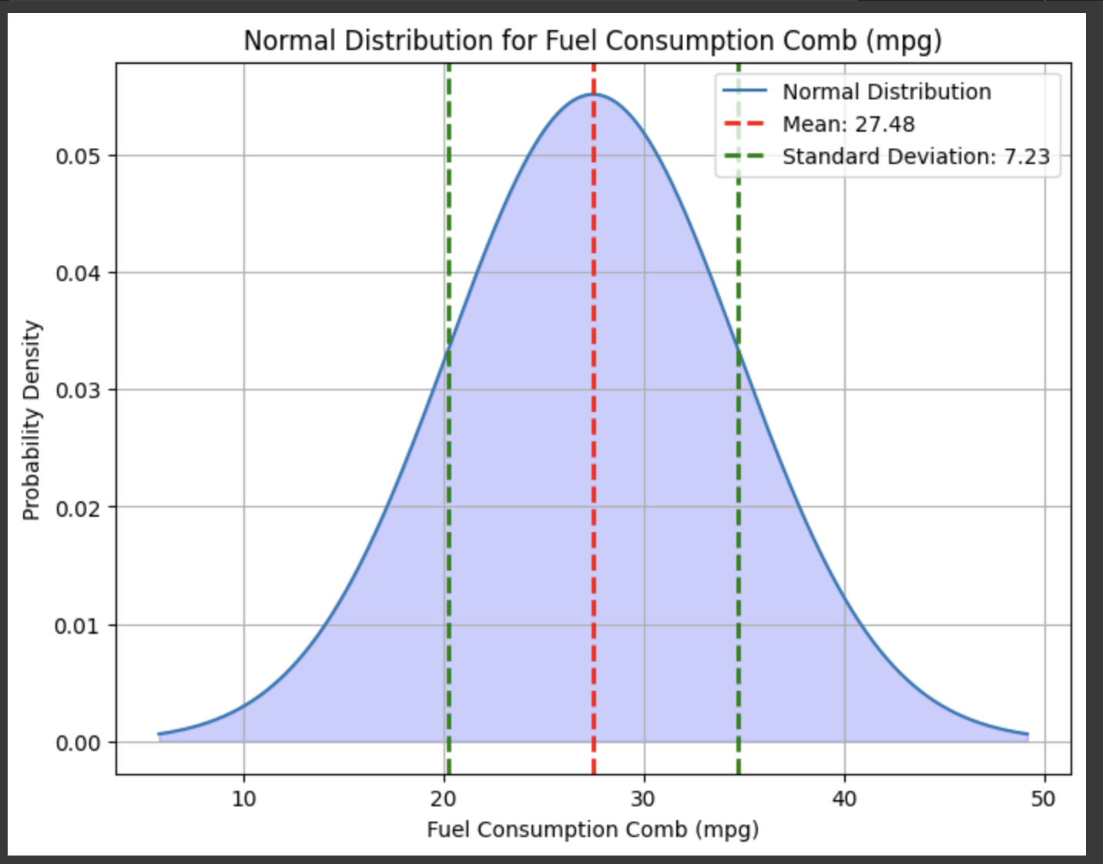
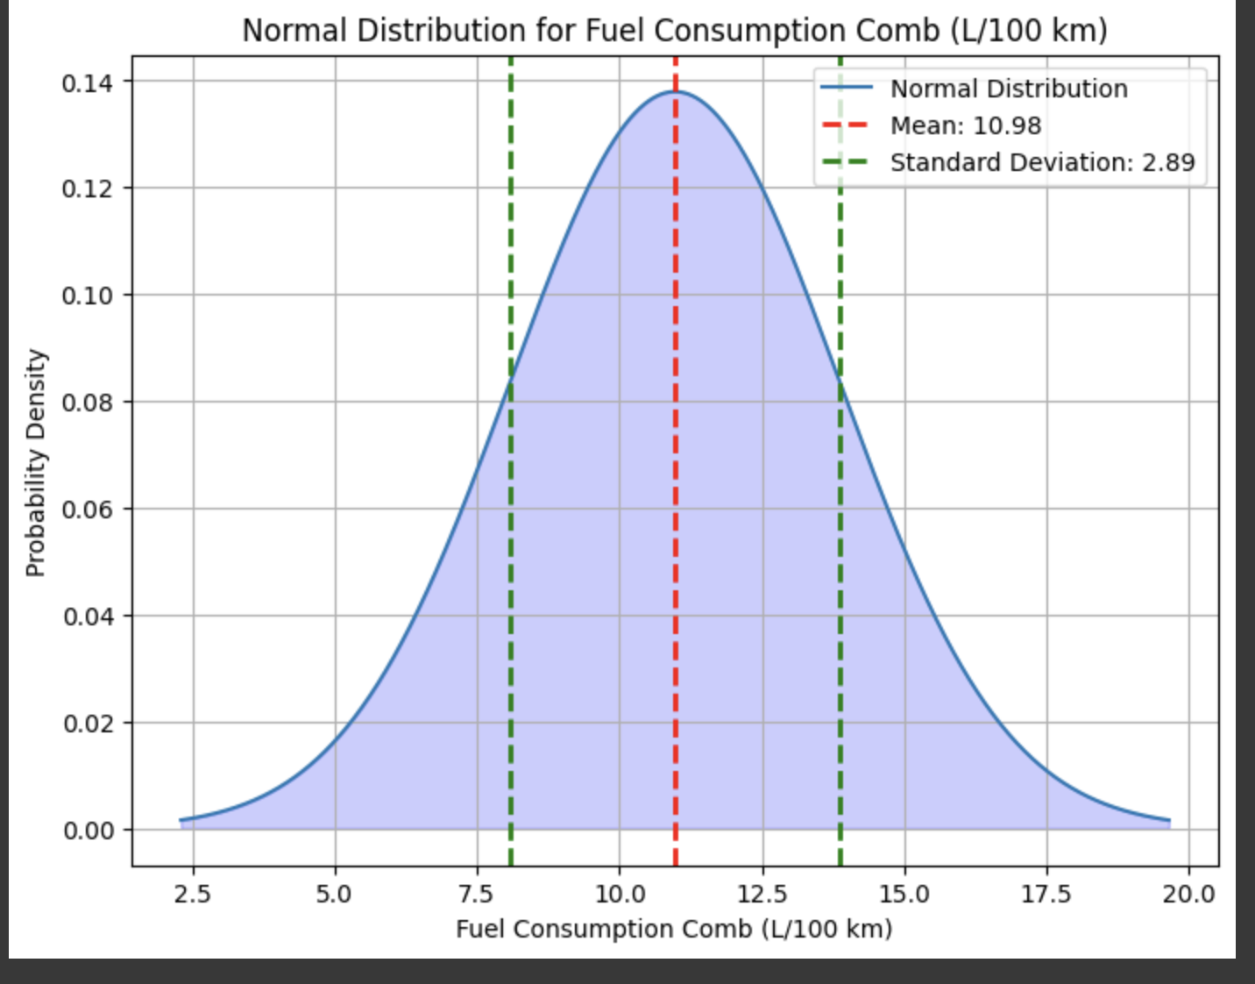
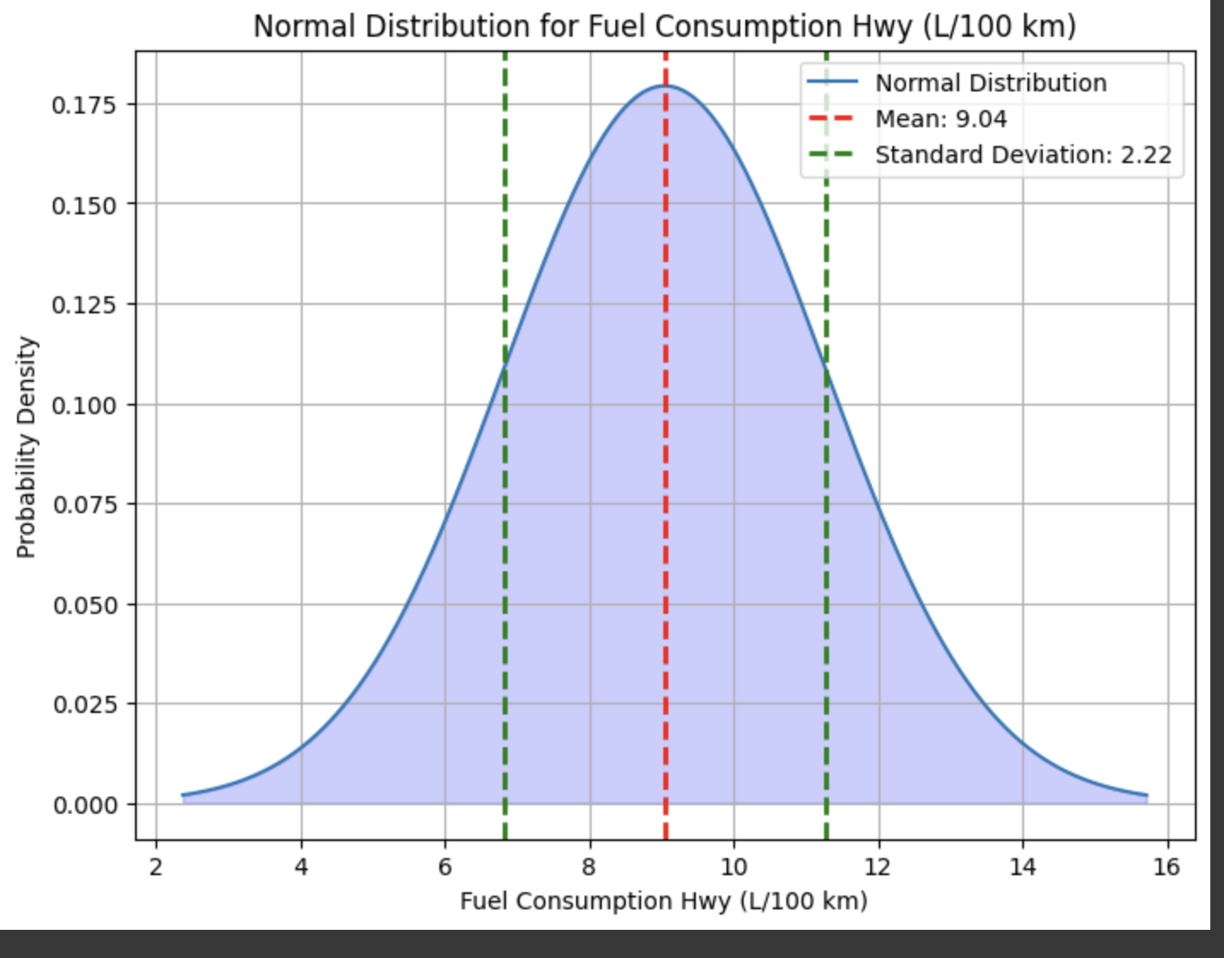
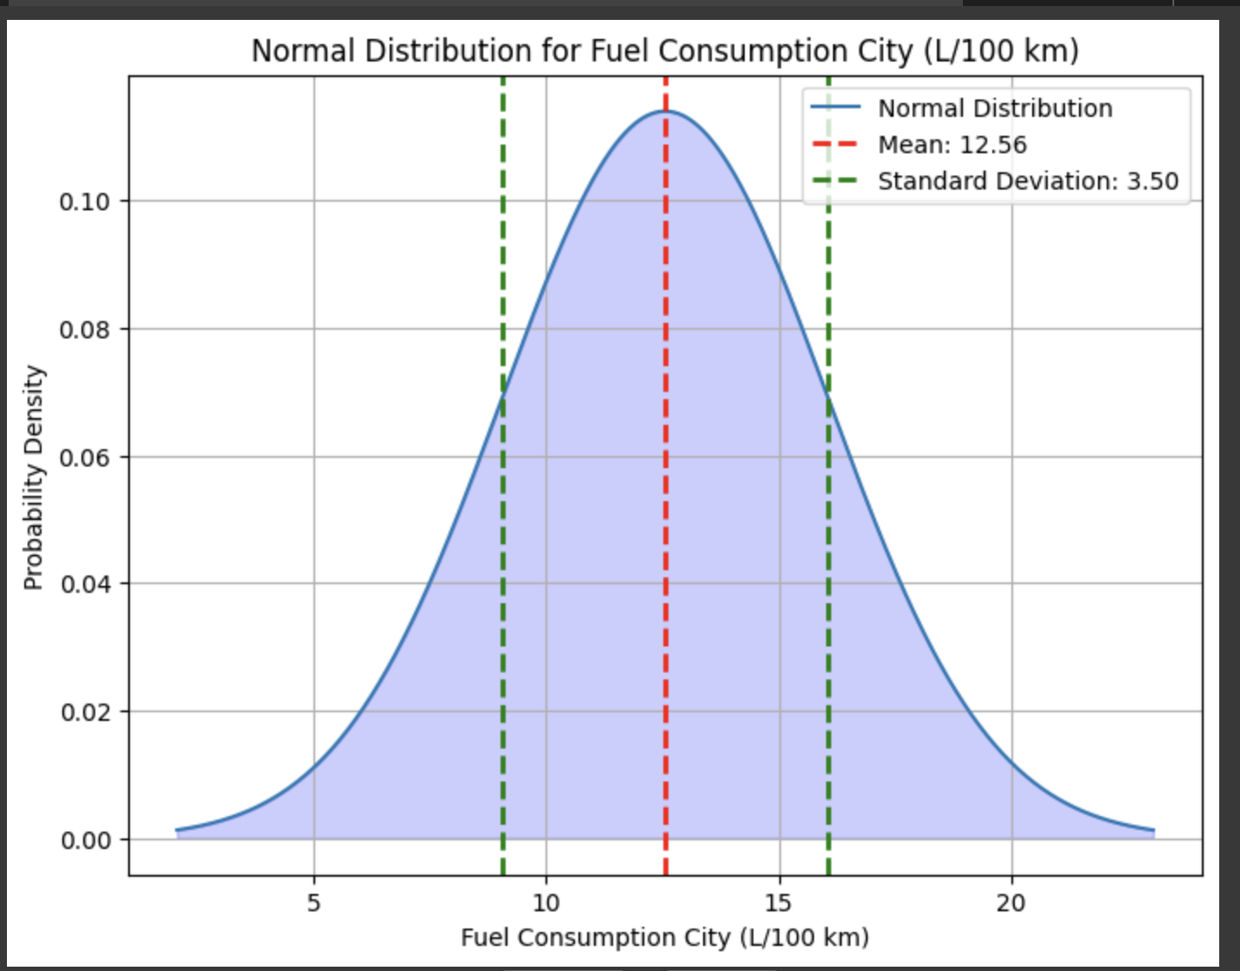
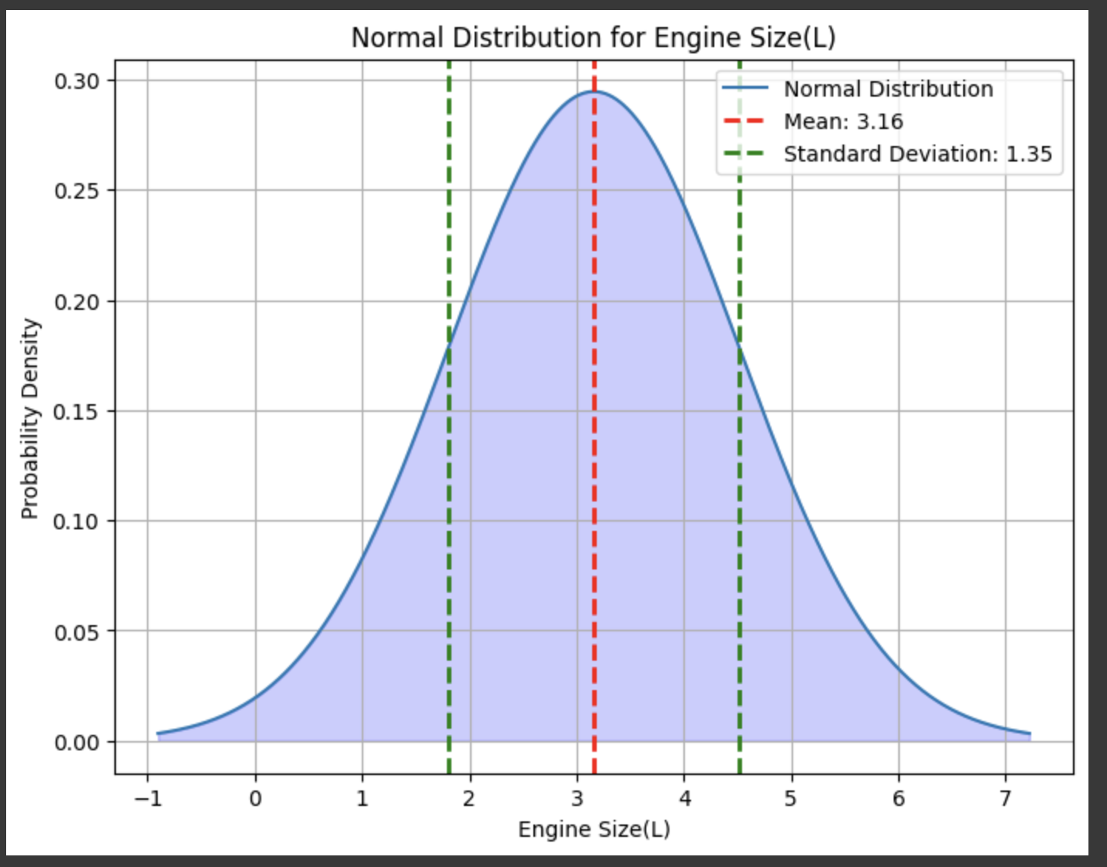
Dispersion Measures

Slide 8
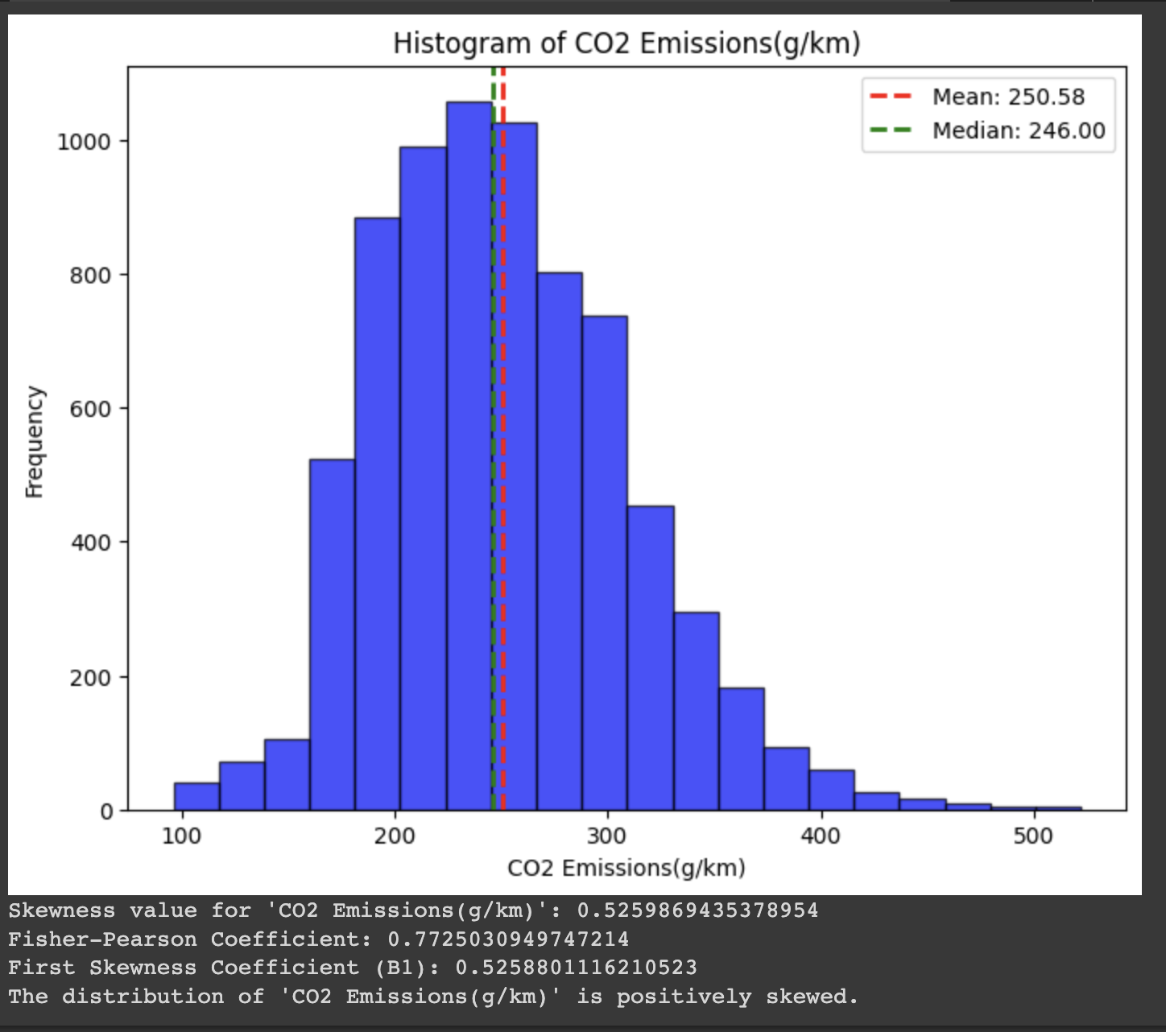
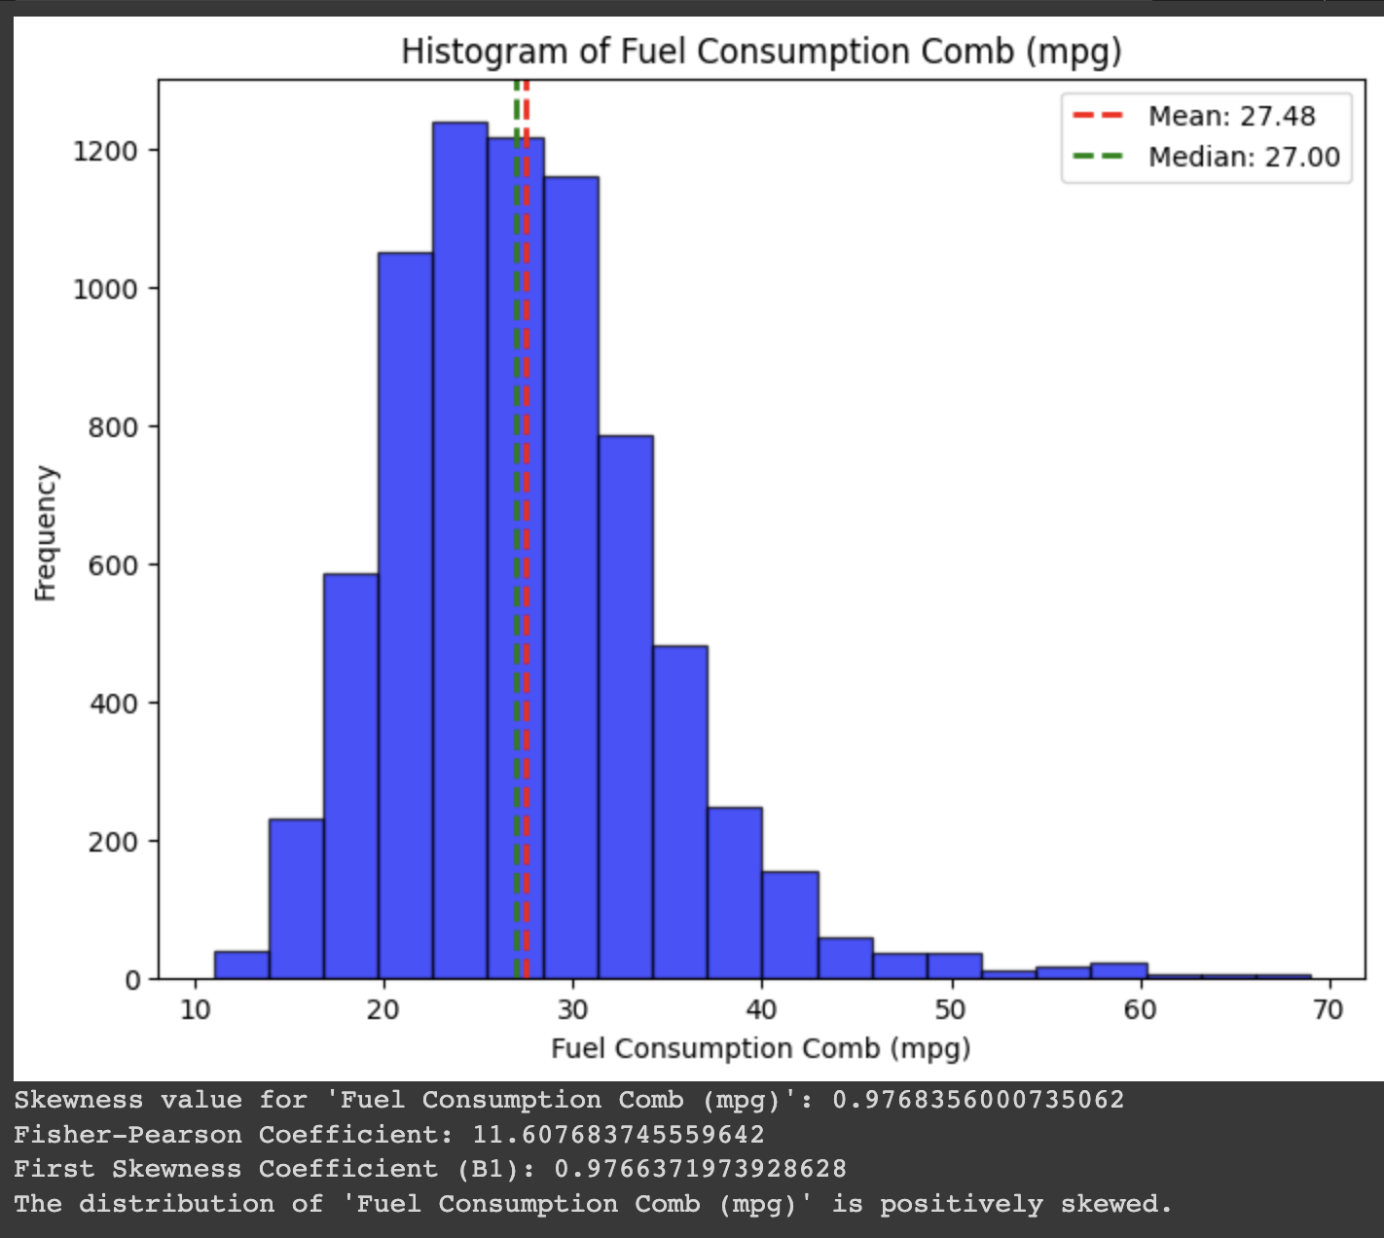
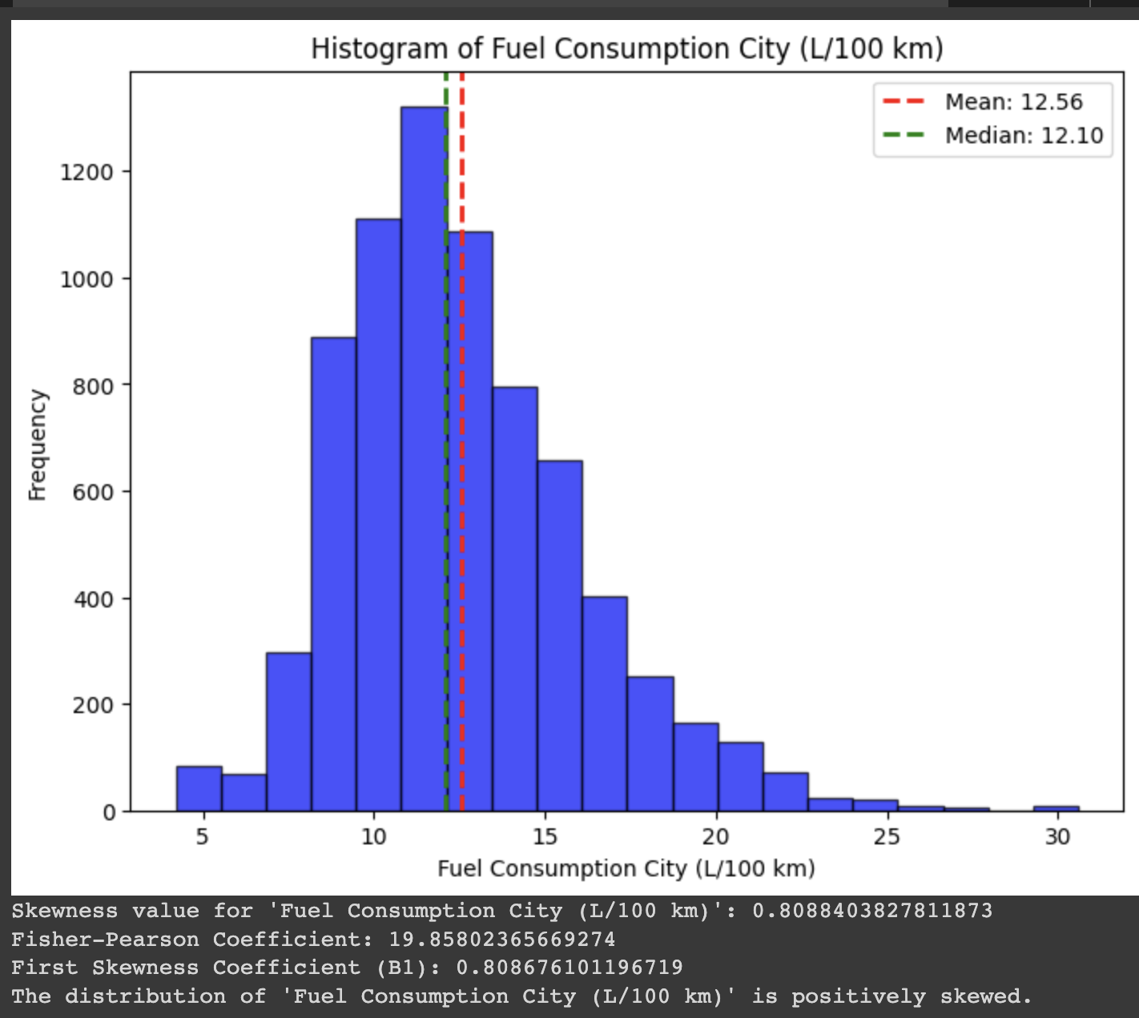
Skewness

Slide 9
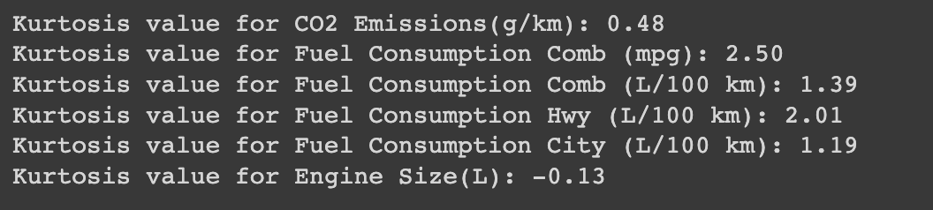
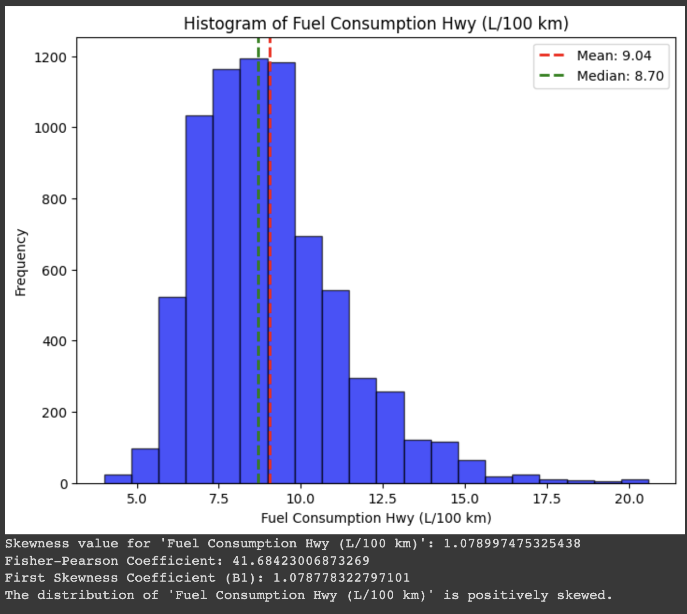
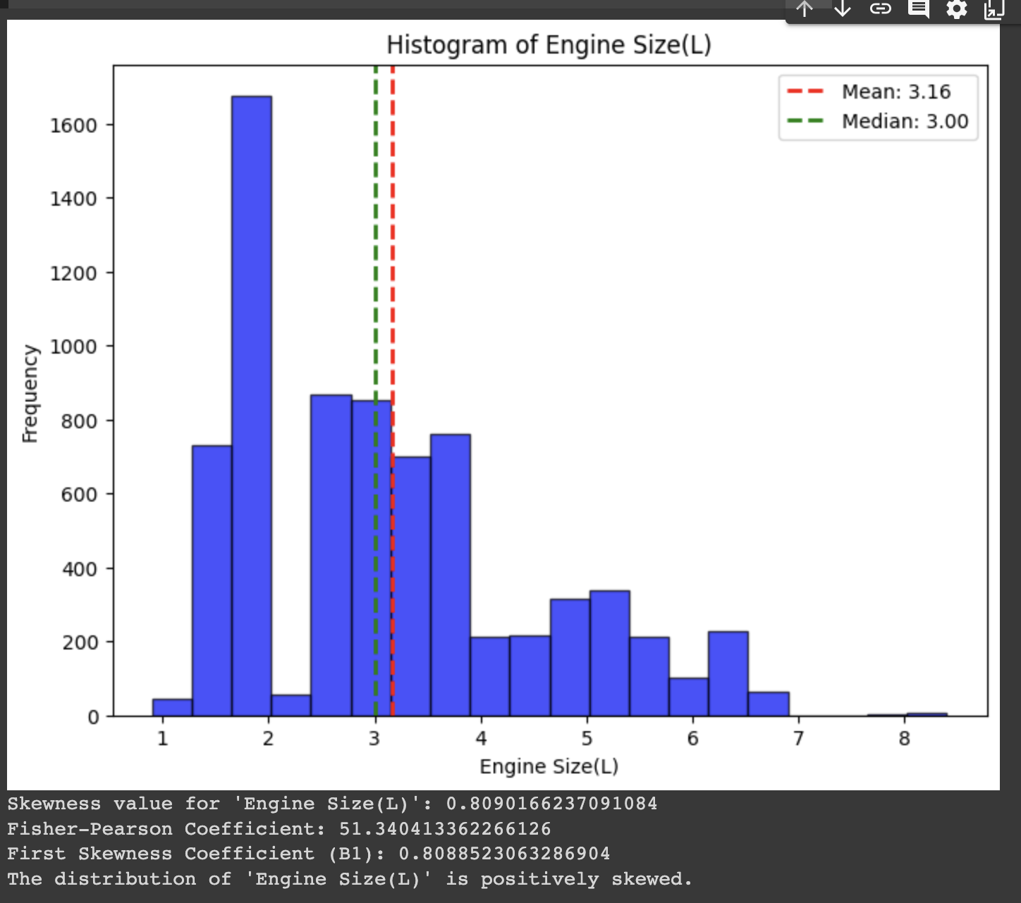
Skewness

Slide 10
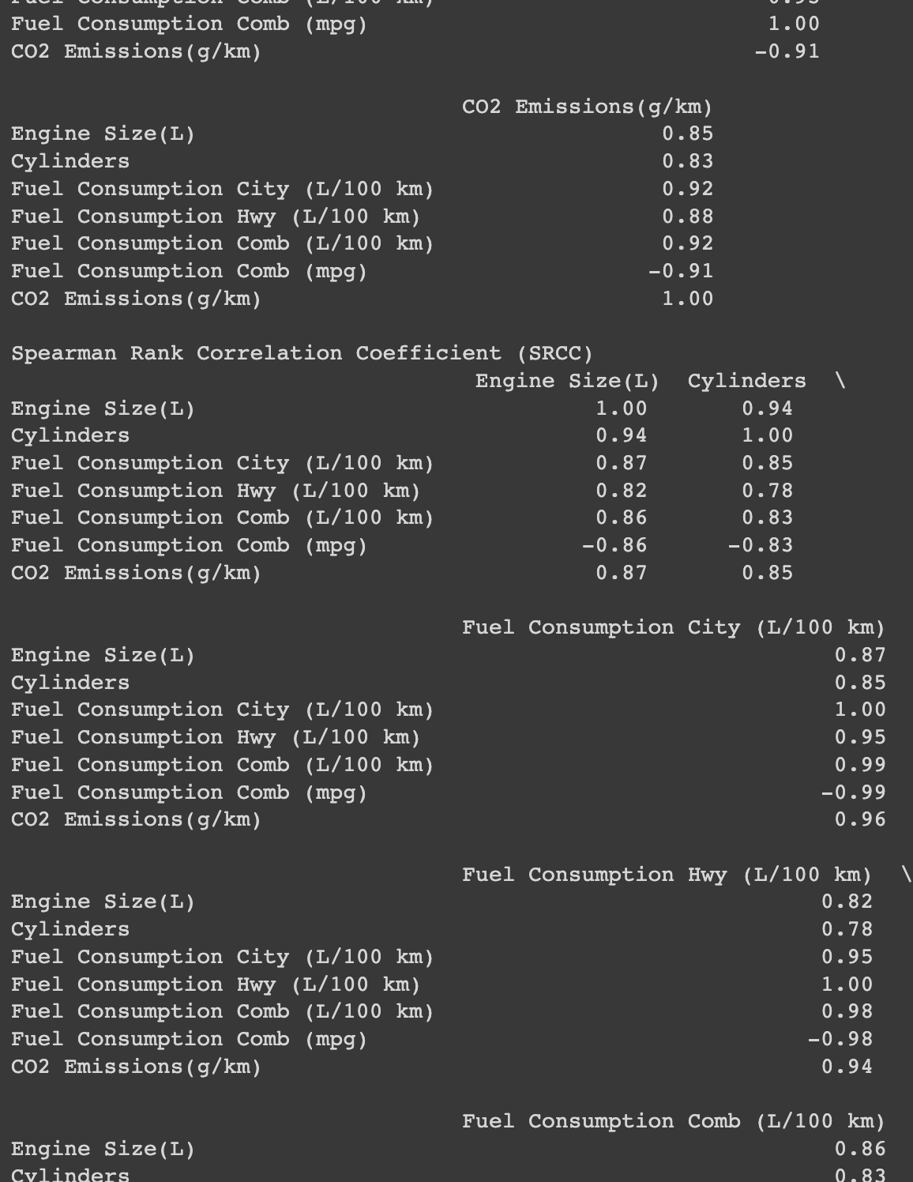
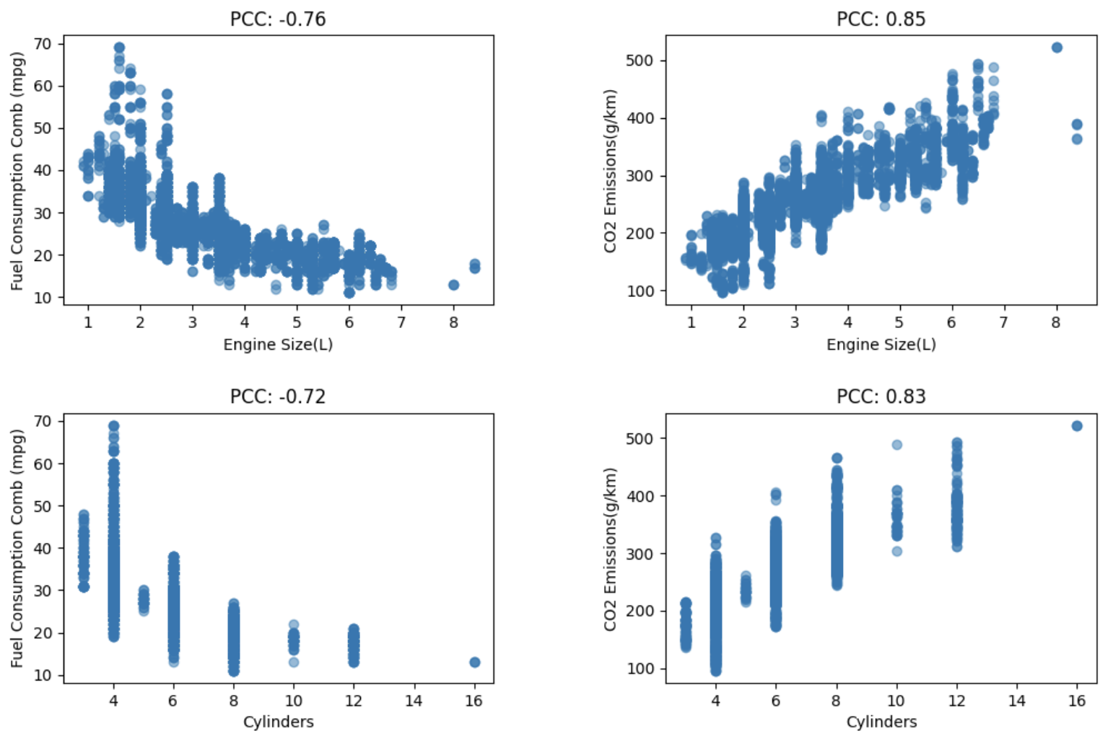
Association Measures

Slide 11
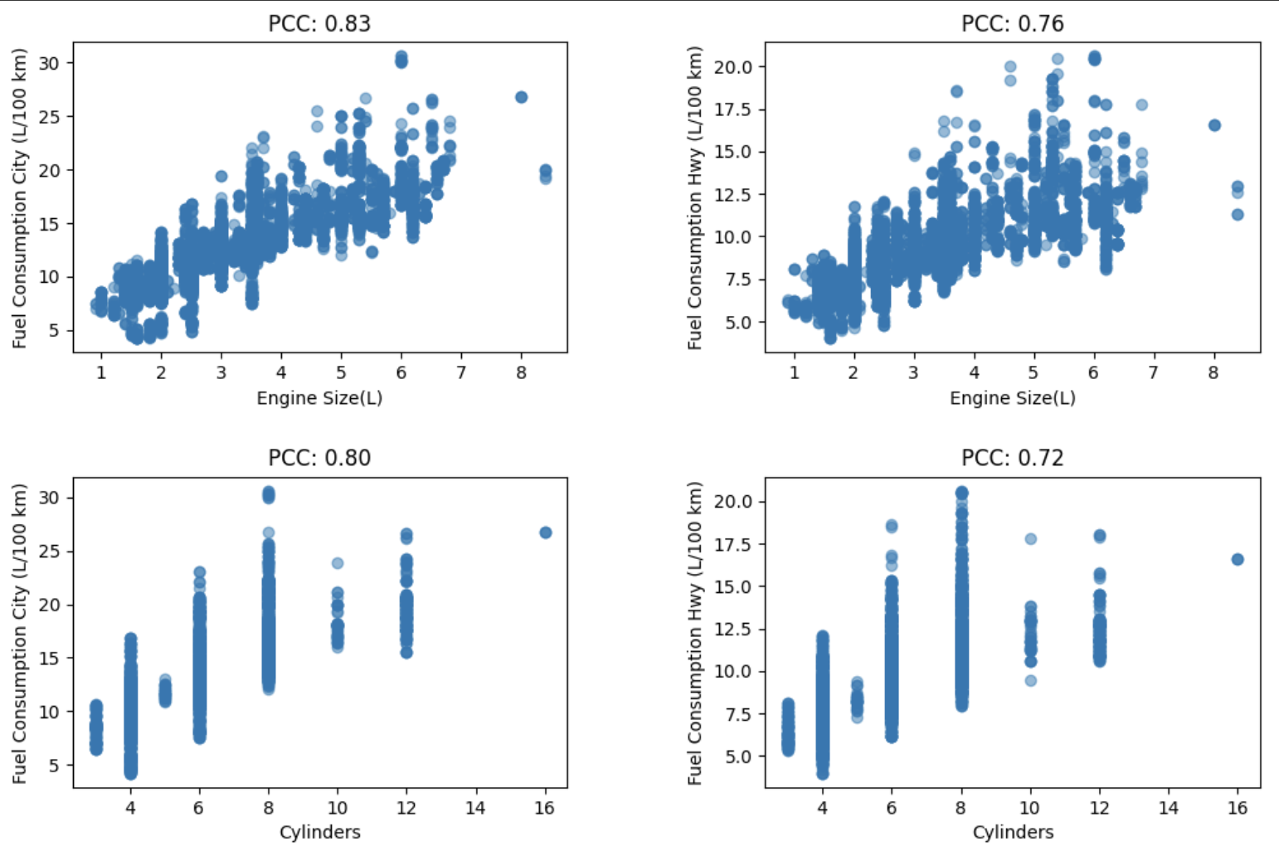
Association Measures

Slide 12
Results
Most the common correlation was the positive correlation between the engine displacement and cylinder number with fuel mileage and CO2 Emissions.
The most fuel efficient vehicles were vehicles witted with 4 cylinder engines.
Most manufacturers make small SUV’s, compact cars, and midsize vehicles and fit them with 4 cylinder engines with small displacement.
There is a negative correlation between between vehicles with high number of cylinders and displacement with the fuel efficiency and CO2 Emissions.
The least fuel efficient engine and displacement were v8 engines with high displacement, even more than 10 12 and 16 cylinder engines.

Slide 13
Conclusion
The study would be more specific if it were to include variables such as engines fitted with turbo chargers or superchargers.
Inclusion of style of driving of a vehicle in the real world.
Adding electric car emissions saved vs manufacturing emissions.
Probability of purchasing a vehicle with high fuel efficiency is much greater when engine is 4 cylinders or 2.0 L of displacement.

